Slide 2
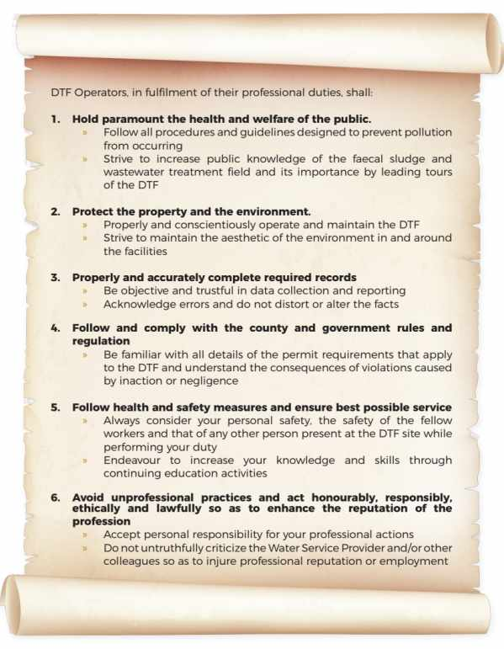
CODE OF CONDUCT
Wastewater and faecal sludge operations is a professional occupation that requires education, training and experience. In this profession, staff involved in the operation of a DTF must be dedicated to the protection of public health and act skilfully and conscientiously. DTF Operators have a direct impact on the environment, the preservation and protection of which affects the quality of life for all residents.

Slide 3
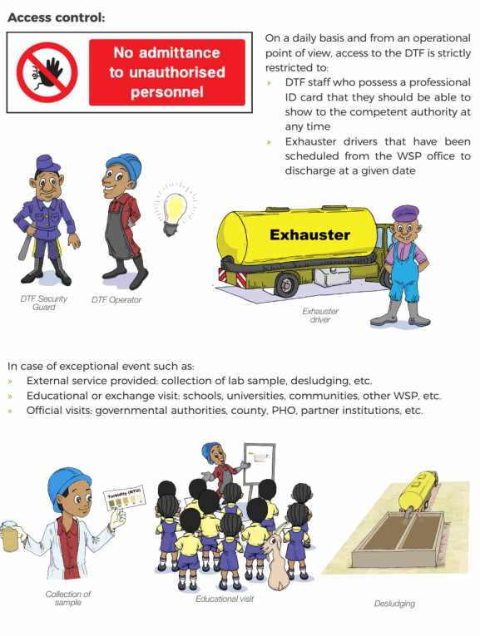
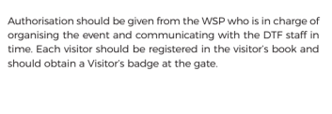
SITE REGULATION
Define your operating hours:
Example
Monday to Saturday
From 8am to 7pm

Slide 4
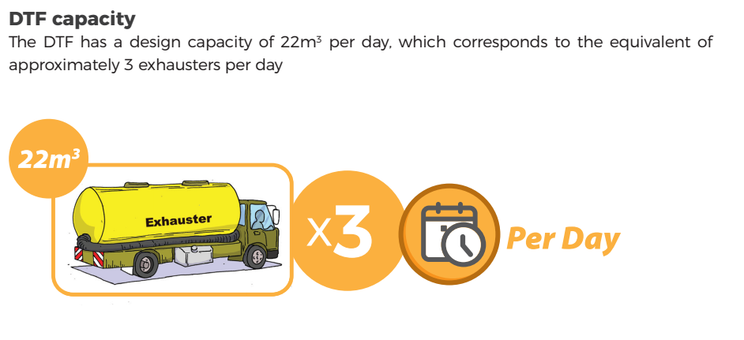
DISCHARGE RULES

Slide 5
